Slide 1

Effects of Scoliosis on Pulmonary Functions in Children
Hanna Schroeder Samantha Cailey Ammara Talib

Slide 2
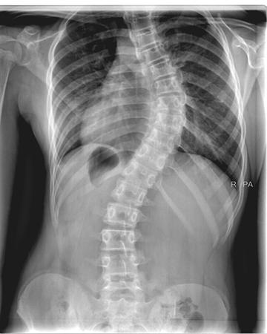
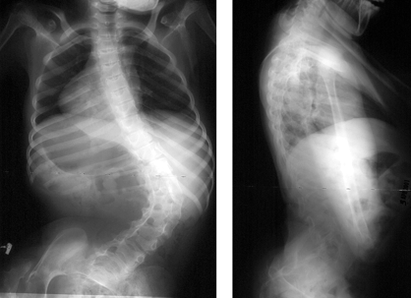
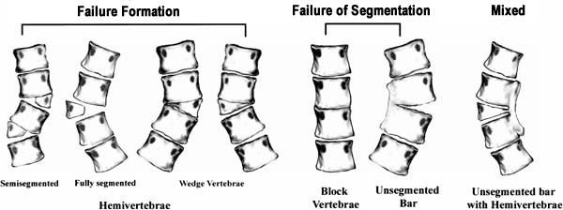
Introduction to Scoliosis
Orthobullets photo on Congenital Scoliosis
Orthobullets photo of Cerebral Palsy
As an example of Syndromic Scoliosis
Orthobullets photo on Idiopathic Scoliosis
Signs: lateral curvature of the spine, uneven shoulders, uneven hips
Can occur at all regions (cervical, thoracic, lumbar, combination)
Types
Syndromic – neuromuscular, connective tissue, or skeletal disorders (spina bifida)
Congenital – abnormally formed vertebrae
Idiopathic – most common, no known cause

Slide 3
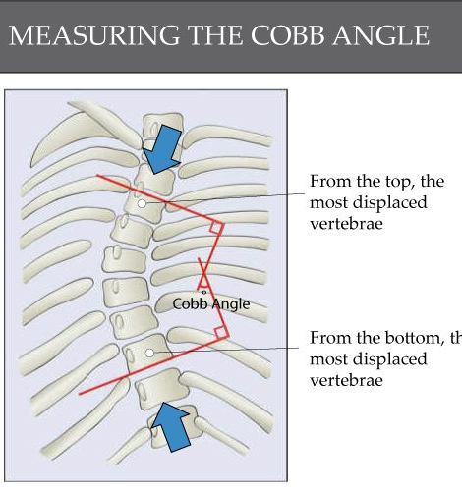
How to Diagnose Scoliosis
Know the patient’s health history (neuromuscular conditions, family history, fetal development)
Lateral curvature of the spine greater than 10 degrees in the coronal plane
Surgery is recommended for patients with a curve angle more than 45-50 degrees.
Image from Core Concepts, The
Muscle and Bone People

Slide 4
Project Objectives
We suspect from other research that scoliosis affects the pulmonary function in children.
Decrease the chest wall
leading to more difficult breathing during rest, exercise and sleep.
Early spinal fusion from scoliosis effects lung growth in young children
Overall, scoliosis is an anatomical disease that can have more implications on the body anatomically because of the curvature.

Slide 5
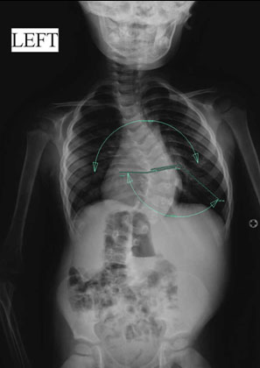
Anatomical Impacts of Idiopathic Scoliosis on Pulmonary Function
Upper chest is funnel shaped in IIS
T 1-4 ribs significantly narrowed
Also documented to be narrower in AIS patient
Narrow chest– insufficient space for alveolar growth
Results in restrictive extrinsic lung disease
More curvature = lung on convex side more compressed
More rotation = compression or distortion of the lungs
Flattened in the lateral plane

Slide 6
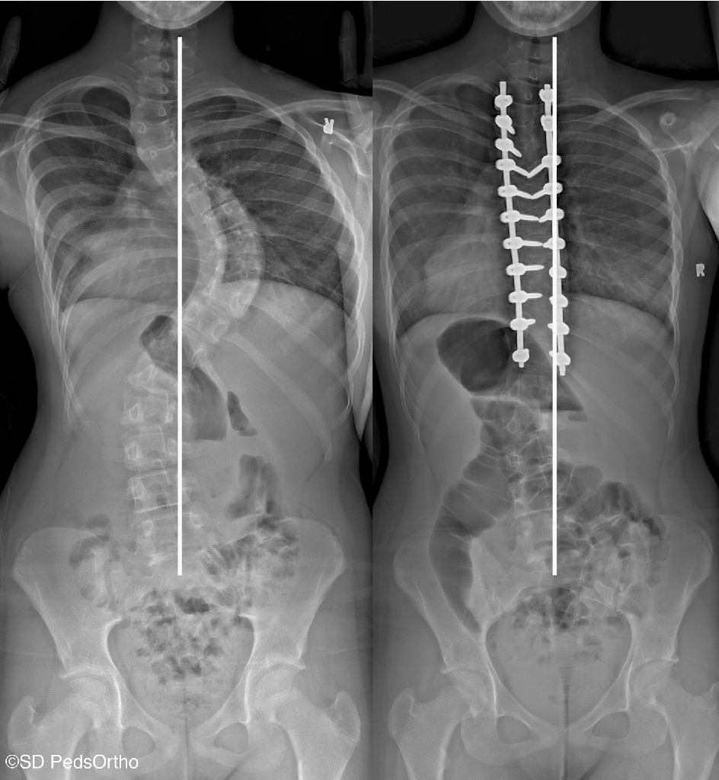
Effects of Thoracic Fusion on Pulmonary Function
Spinal fusion connects two or more vertebrae in your spine, eliminating motion between them
thoracic fusion
Purpose of study was to determine pulmonary function at immediate-term follow up in children who underwent this surgery

Slide 7
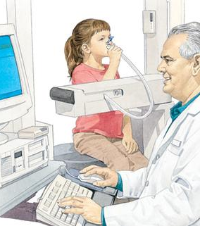
Methods
Minimum five-year follow-up of pulmonary testing
Various tests were performed
Compared with age-matched normal values
Some patients were excluded
Those with rib malformations were included
Relationships between forced vital capacity and many variables were studied

Slide 8
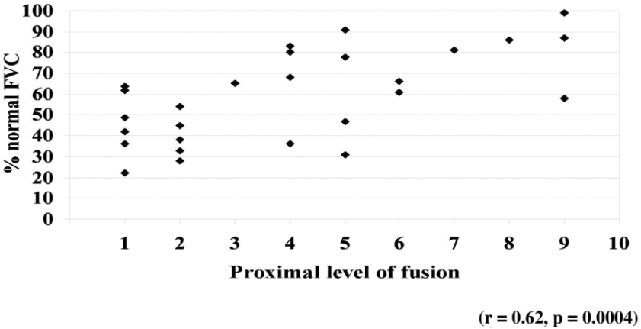
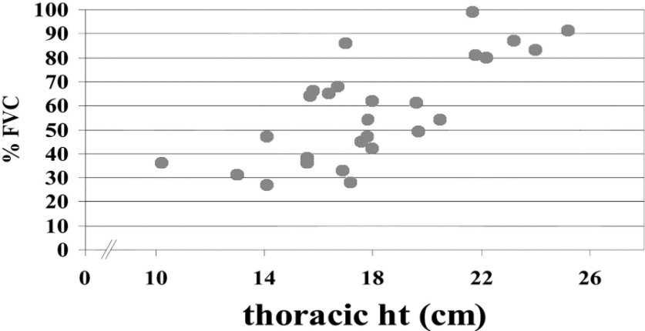

Overall Findings
Relationship between the % of thoracic vertebrae fused and pulmonary compromise
Patients with fusions included T1 and T2 had the greatest pulmonary compromise with FVC <50% r = 0.62, p < 0.0004).
Patients with the shortest thoracic spinal height (measured from T1 to T12) had the greatest restriction of pulmonary volume r = 0.73, p < 0.001).
Thoracic height at the time of follow-up versus the % of predicted forced vital capacity (FVC)

Slide 9
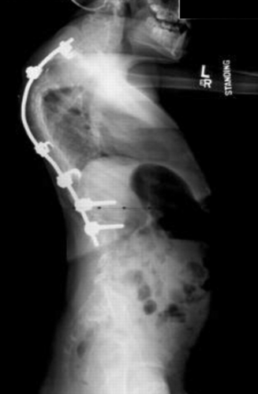
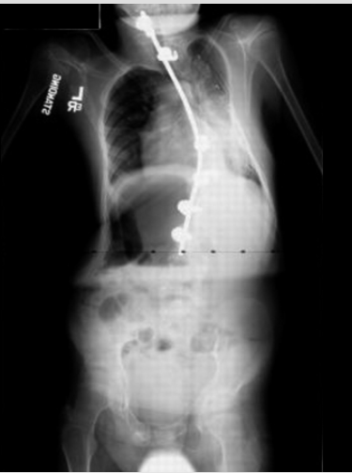
Overall Findings
Thoracic spine measurement of 11-year-old
Forced expiratory volume in one second was only 31% of normal values
Thoracic spine measured 16.9 cm <normal thoracic height of a five-year-old child

Slide 10
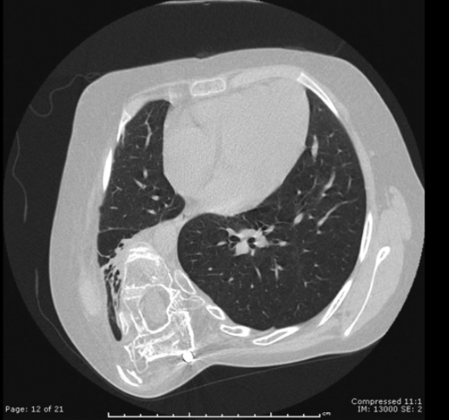
Overall Findings
Computed tomography scan of the chest, made when the patient was 12.8 years old
Forced expiratory volume in one second was only 27 % of normal values
diminished maximum inspiratory pressure
chest weakness
hypercarbia
Thoracic spine measured 14.1 cm, < normal value for a five-year-old child

Slide 11
Conclusion

Slide 12
References
Tsiligiannis, T., & Grivas, T. (2012). Pulmonary function in children with idiopathic scoliosis. Scoliosis, 7(1), 7.
Huh, S., Eun, L. Y., Kim, N. K., Jung, J. W., Choi, J. Y., & Kim, H. S. (2015). Cardiopulmonary function and scoliosis severity in idiopathic scoliosis children. Korean journal of pediatrics, 58(6), 218.
Ledonio, C. G. T., Rosenstein, B. E., Johnston, C. E., Regelmann, W. E., Nuckley, D. J., & Polly Jr, D. W. (2017). Pulmonary function tests correlated with thoracic volumes in adolescent idiopathic scoliosis. Journal of Orthopaedic Research, 35(1), 175-182.
Takahashi, S., Suzuki, N., Asazuma, T., Kono, K., Ono, T., & Toyama, Y. (2007). Factors of thoracic cage deformity that affect pulmonary function in adolescent idiopathic thoracic scoliosis. Spine, 32(1), 106-112.
Abbasi, D., & Shilt, J. (2020, June 23). Congenital Scoliosis. Retrieved December 01, 2020, from https://www.orthobullets.com/spine/2060/congenital-scoliosis
Moore, D. (2018, October 17). Cerebral Palsy - Spinal Disorders. Retrieved December 01, 2020, from https://www.orthobullets.com/spine/2057/cerebral-palsy--spinal-disorders
Souder, C. (2020, July 19). Adolescent Idiopathic Scoliosis. Retrieved December 01, 2020, from https://www.orthobullets.com/spine/2053/adolescent-idiopathic-scoliosis
Understanding Cobb Angles And What It Means For Scoliosis. (2020, April 01). Retrieved December 03, 2020, from https://www.coreconcepts.com.sg/article/cobb-angle-and-scoliosis/
https://www.orthobullets.com/spine/2060/congenital-scoliosis
https://www.orthobullets.com/spine/2057/cerebral-palsy--spinal-disorders
https://www.orthobullets.com/spine/2053/adolescent-idiopathic-scoliosis

Slide 13
Group Roles
Introduction, Diagnosis, Objectives – Samantha
Anatomical impacts, Study goals and thoracic fusion, methods – Hanna
Overall Findings Slides – Ammara
Conclusions – Combined

